Slide 1
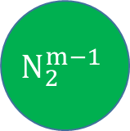
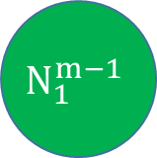
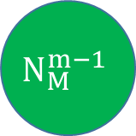

$$N_{1}^{m−1}$$
$$N_{2}^{m−1}$$
$$N_{i}^{m}$$
…
$$N_{M}^{m−1}$$

Slide 2









Propagation function
$i^{th}$ neuron of $m^{th}$ layer
$$w_{1i}^{m}$$
$$a_{1}^{m−1}$$
X
$$w_{2i}^{m}$$
$$a_{2}^{m−1}$$
X
Activation function
+
$$z_{i}^{m}$$
$$a_{i}^{m}$$
…
$$w_{Mi}^{m}$$
$$a_{M}^{m−1}$$
X

Slide 3
N-bit
X
N-bit
2N-bit
N-bit
X
+
Activation fuction
? → N-bit
2N-bit
2N-bit
2N-bit
X
N-bit
…
N-bit
N-bit
X
N-bit
2N-bit

Slide 4
Hidden
N1
Input
Output
N4
N2
N5
N3

Slide 5
















$$w_{11}^{2}$$
$$din1$$
X
$$w_{11}^{3}$$
Sigmoid
X
+
$$w_{21}^{2}$$
$$w_{12}^{3}$$
$$din2$$
X
X
Sigmoid
+
$$dout1$$
$$w_{12}^{2}$$
X
$$w_{21}^{3}$$
Sigmoid
X
+
$$w_{22}^{2}$$
$$w_{22}^{3}$$
X
X
Sigmoid
+
$$dout2$$
$$w_{13}^{2}$$
X
$$w_{31}^{3}$$
Sigmoid
X
+
$$w_{23}^{2}$$
$$w_{32}^{3}$$
X
X

Slide 6
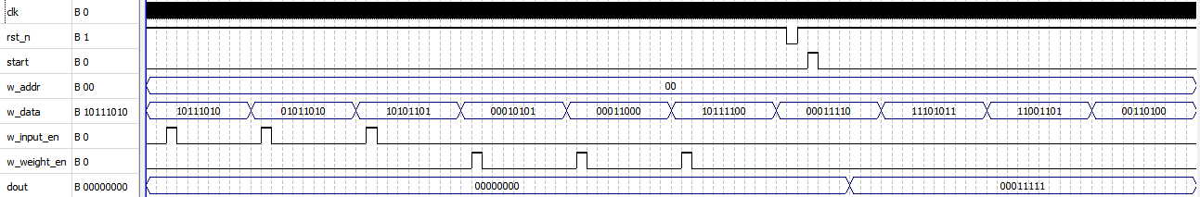
Input1
Input2
Input3
w1
w2
w3
Output

Slide 7
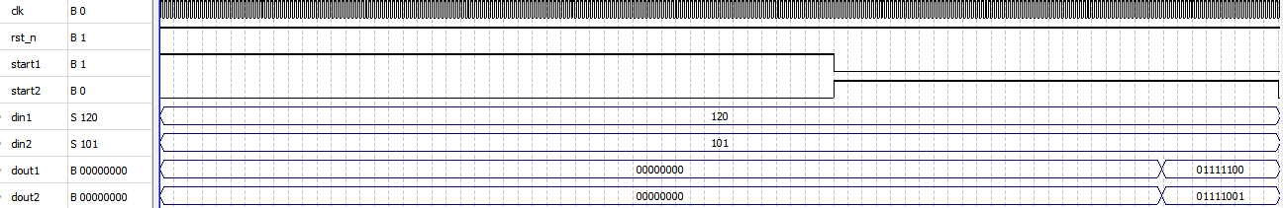
Input1
Input2
Output2
Output2

Slide 8
Mạch nhân 2 số có dấu sử dụng giải thuật Booth
clk
Y
rst_n
start
SBN
done
SN

Slide 9
Hàm kích hoạt sigmoid
clk
ena
activation
net_val

